Slide 1

Secure Python Login And Jwt Security Powered By Python
&Dynamic RBAC & MongoDB With Fast Api

Slide 2

ABSTRACT
The rapid growth of web applications and digital platforms has increased the demand for secure, scalable, and efficient backend systems. This project, “Secure API Development with Fast API, MongoDB, JWT, and Role-Based Access Control (RBAC),” focuses on implementing robust security practices while designing RESTful APIs.
Secure Python Login And JWT Security Powered By Python
&Dynamic RBAC & Mongodb With Fast Api

Slide 3
OBJECTIVES
Prioritize Data Security
Password Hashing with bcrypt
JWT Authentication
RBAC
Input Validation
TLS
Event Logging
Demo Project structure and results
Secure Python Login And JWT Security Powered By Python
&Dynamic RBAC & Mongodb With Fast Api

Slide 4
PASSWORD HASHING
here we are using the “re” .It provides powerful tools for pattern matching for password
Example:-
validate_password("Thiru123@") # ✅ True (valid)
validate_password("thiru123")) # ❌ False
bcrypt hashing with salt & cost factor ensures passwords are not stored in plain text and resists brute-force
example:-
Password = "Secure123!"
Hash 1 = $2b$12$w.3N7Y3gWm6FQfY...
Hash 2 = $2b$12$8Km4szF7gA9Yx...
Even though the password is the same, the hashes are different due to unique salts.
Secure Python Login And JWT Security Powered By Python
&Dynamic RBAC & Mongodb With Fast Api

Slide 5
JWT AUTHENTICATION
JWT (JSON Web Token) is an open standard used for securely transmitting information between parties as a JSON object.
example:-
Token :-eyJhbGciOiJIUzI1NiIsInR5cCI6IkpXVCJ9.
eyJzdWIiOiJ1c2VyMTIzIiwicm9sZSI6ImFkbWluIiwiZXhwIjoxNjkzOTEwNDIzfQ.
U2h2R6Jw9eZCjz3PpYVwFGa5u8XgJcUt0SOTvYO7c2k
token contains three parts
Header – Contains metadata, including the signing algorithm.
Payload – Contains user data (claims).
Scret key

Slide 6

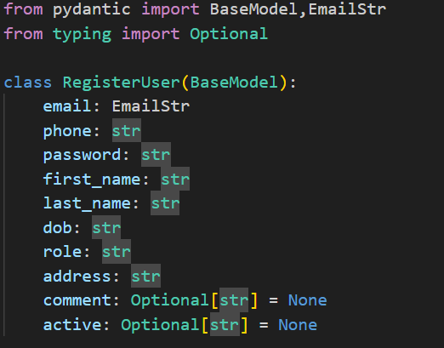
INPUT VALIDATION
Pydantic validates inputs. . At the center of this system is the BaseModel class, which allows developers to define the structure, validation rules, and constraints for input/output data.
Automatic Validation – No need for manual if checks.
Error Handling Built-in – Invalid inputs automatically return error messages.
Clean & Readable Code – Define schema once, use everywhere.

Slide 7
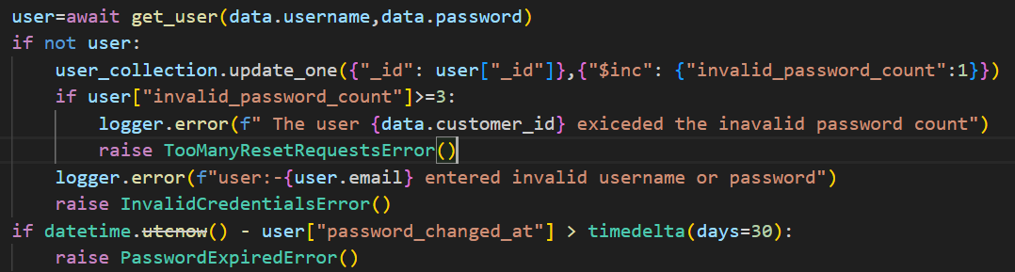
Rate Limiting
Defends against brute-force and API abuse by restricting login attempts per IP/user.

Slide 8
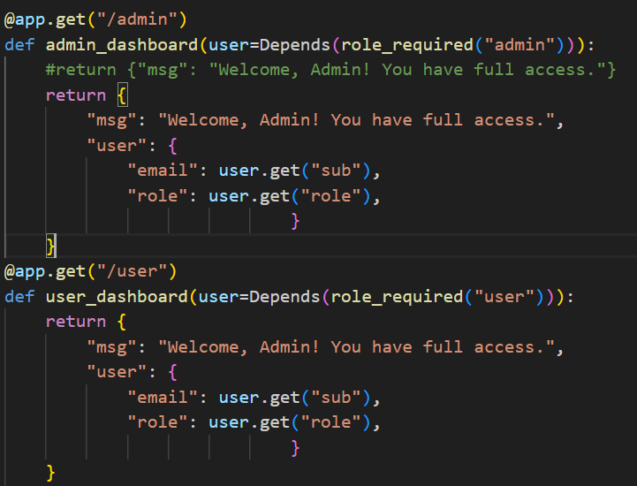

ROLE-BASED ACCESS CONTROL
In a secure application, not every user should have the same level of access.
For example:
An Admin can manage users, view logs, and change roles.
A Normal User can only access their personal dashboard.
This type of access restriction is called Role-Based Access Control (RBAC).

Slide 9
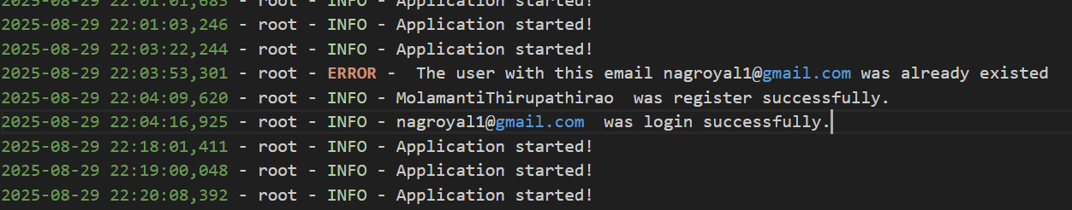
EVENT LOGGING
Security event logging is the process of recording and monitoring events related to security in an application. In this project, since we deal with sensitive operations like login, JWT authentication, and role-based access, logging is essential
Example:-

Slide 10
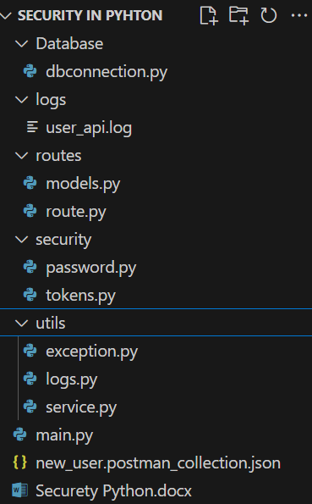
Project structure

Slide 11
REQUIREMENTS
Python
FastAPI
MongoDB
bcrypt
PyJWT
Postman
Uvicorn .

Slide 12
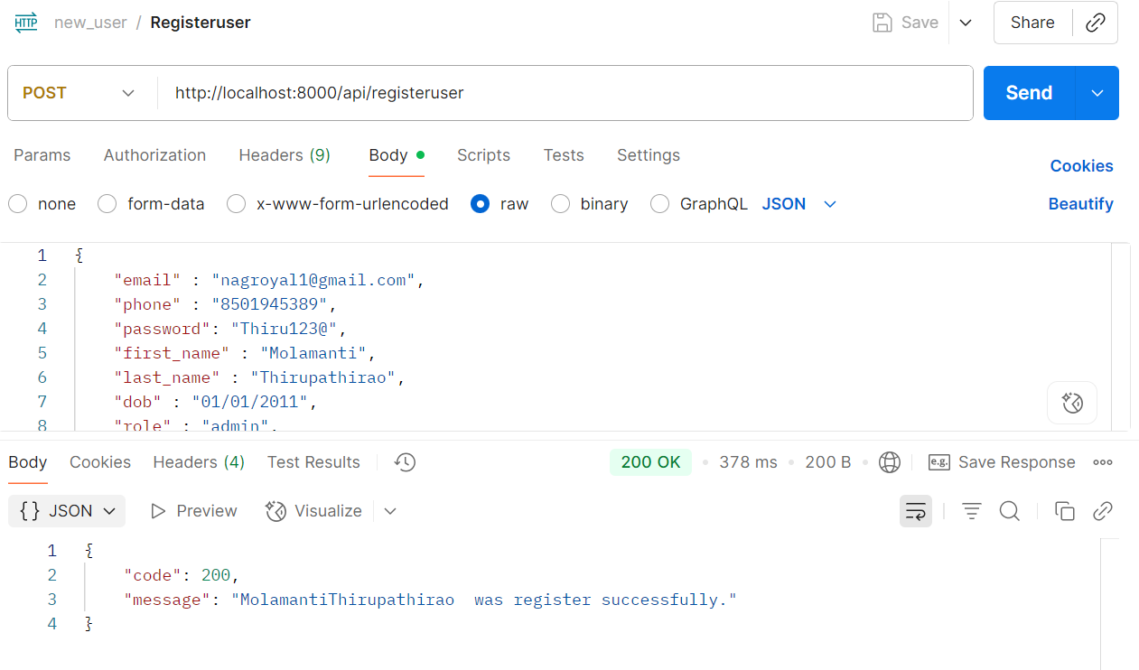
POSTMAN TESTING RESULTS
1.REGISTER SUCSSFULLY:-

Slide 13
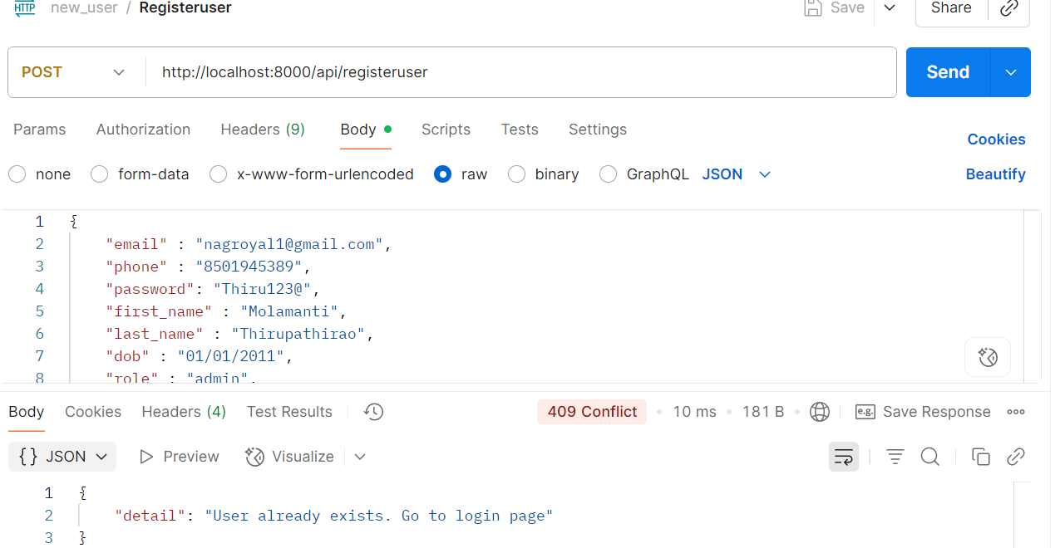
2.USER ALREADY EXISTES

Slide 14
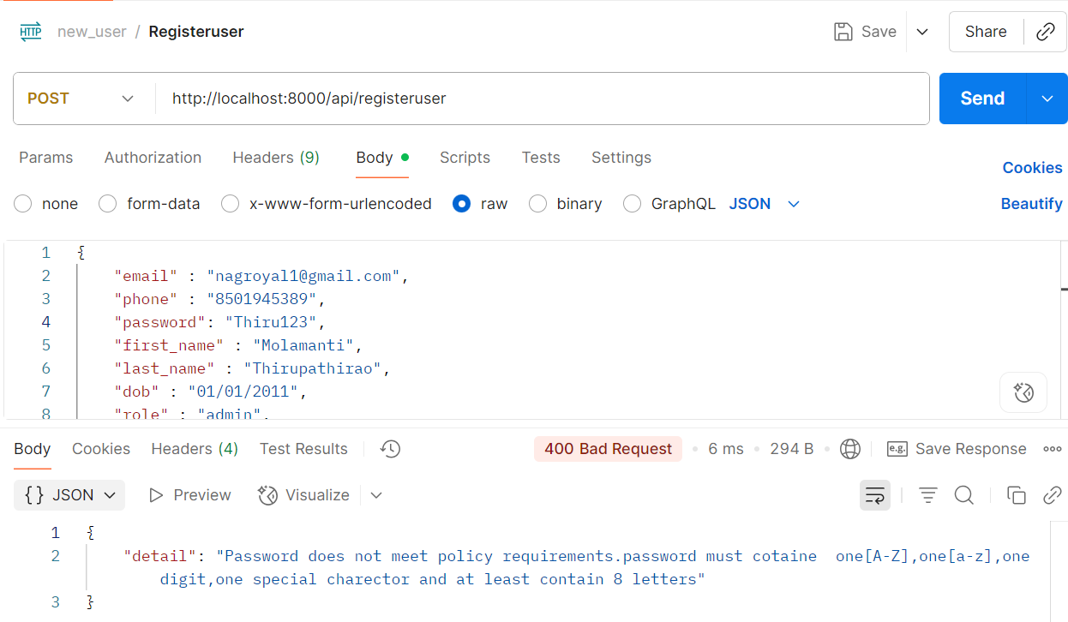
3.PASSWORD DOES NOT MATCHING REQUIRED PARAMETERS;-

Slide 15
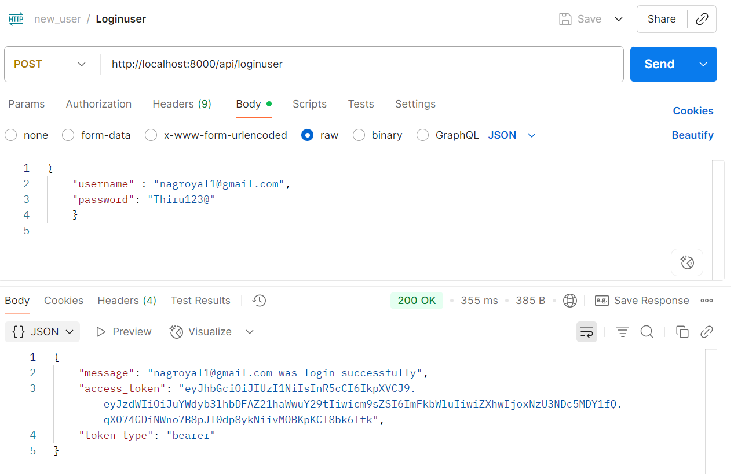
4.LOGIN SUCCESSFULLY:-

Slide 16
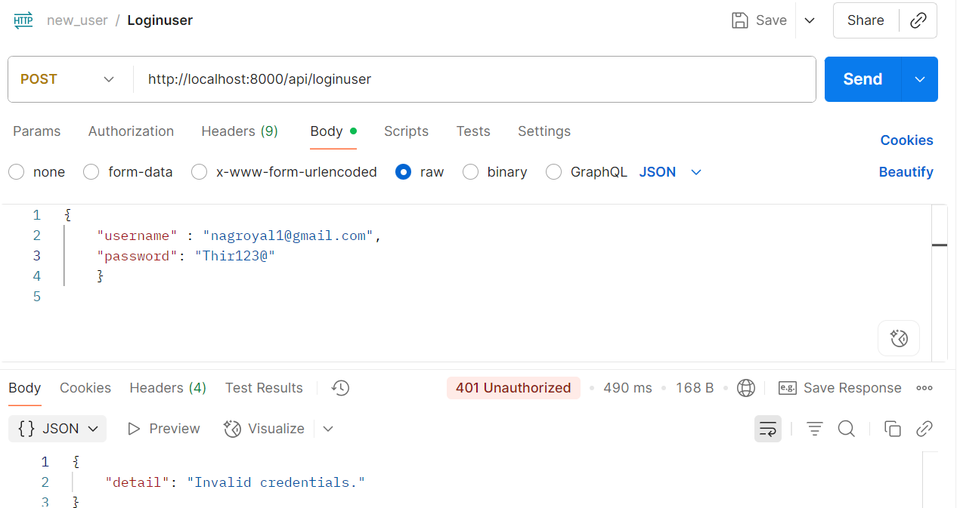
5.INVALID CREDIDENTIALS:-

Slide 17
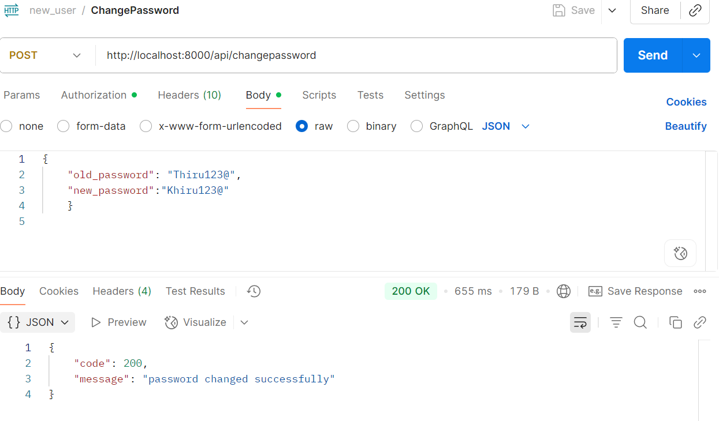
6.PASSWORD CHANGED SUCCESSFULLY:-

Slide 18
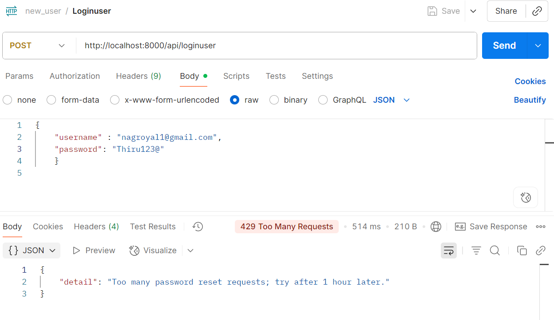
7.TOOMANY PASSWORD RESET:-

Slide 19
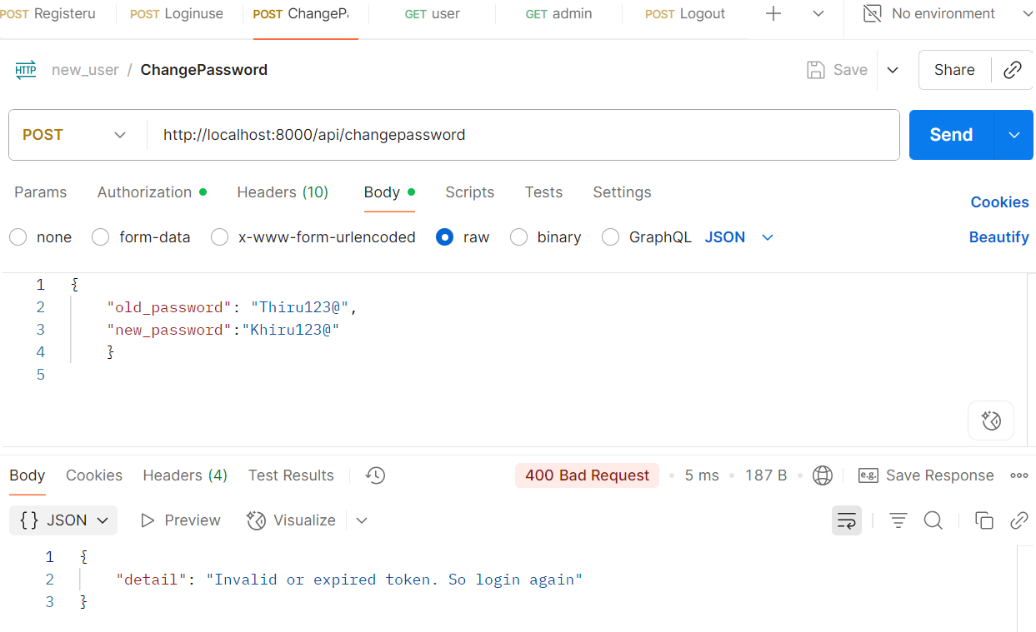
8.INVALID TOKEN AND TOKEN EXPIRED

Slide 20
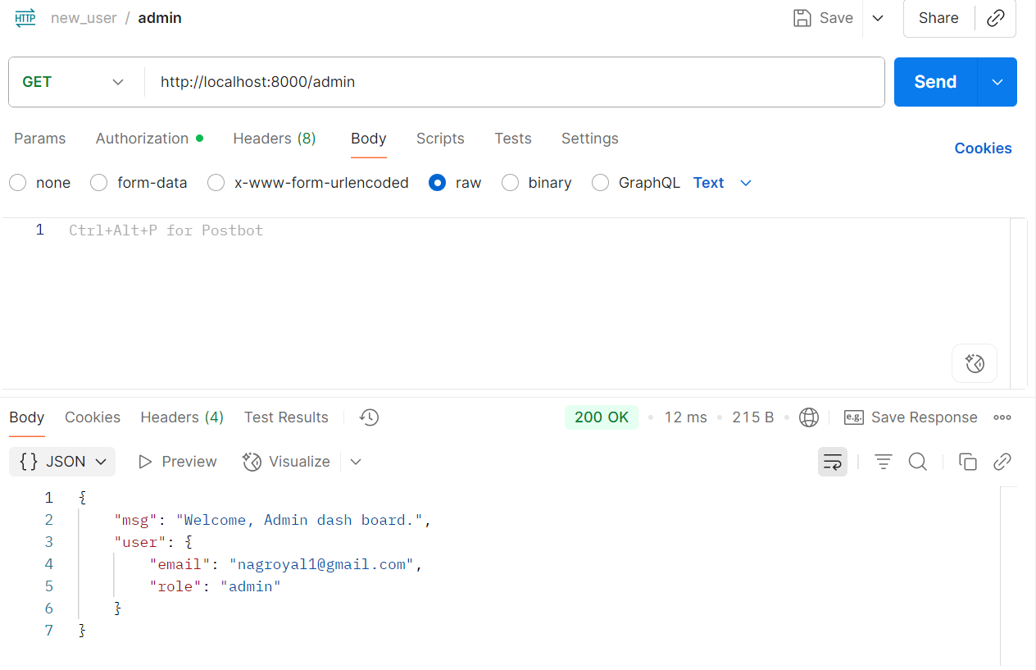
9.WELCOME TO ADMIN DASH BOARD:-

Slide 21
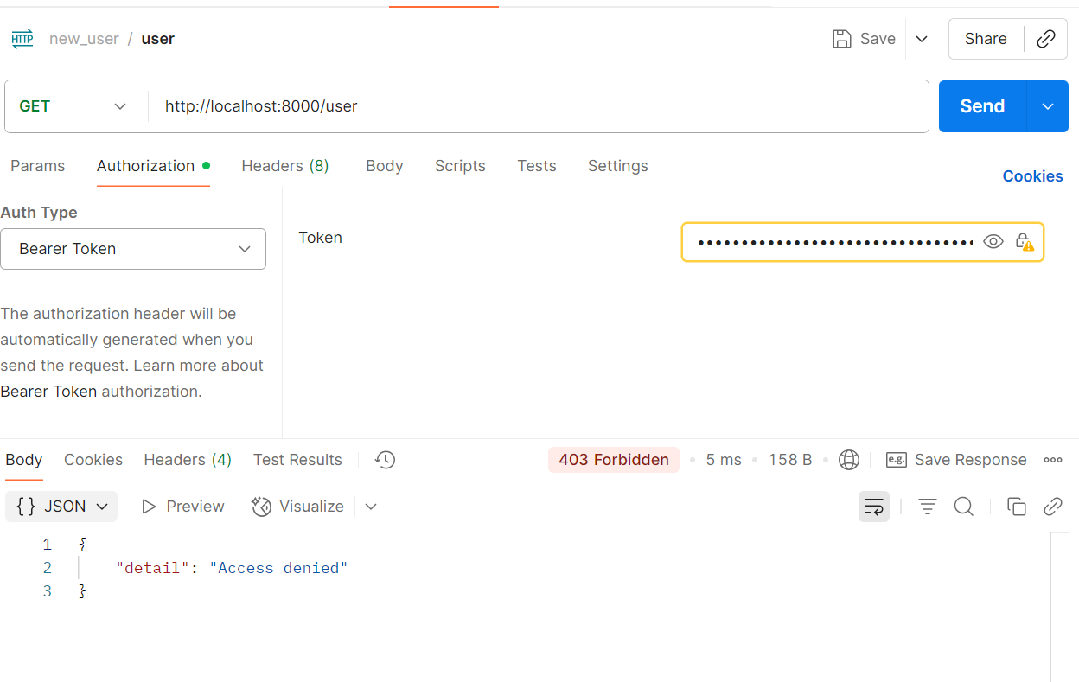
10.ACCESS DENIED ERROR:-

Slide 22
CONCLUSION
Secure authentication system using bcrypt, JWT, RBAC, TLS, and logging. Demonstrates production-ready practices.
In this project, we successfully implemented a secure authentication and authorization system using FastAPI and MongoDB, following industry-standard best practices.
PPT Deck Name

Slide 23
Thank You!!!

